Slide 1
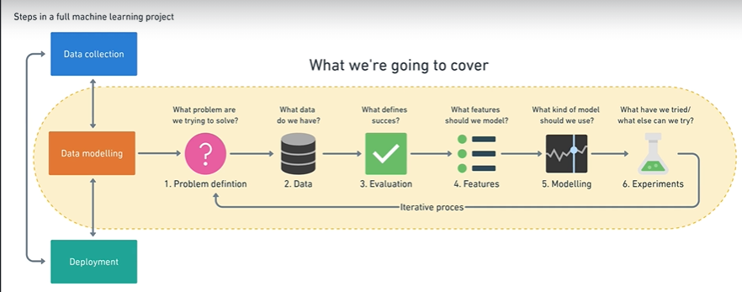
Quick recap!

Slide 2
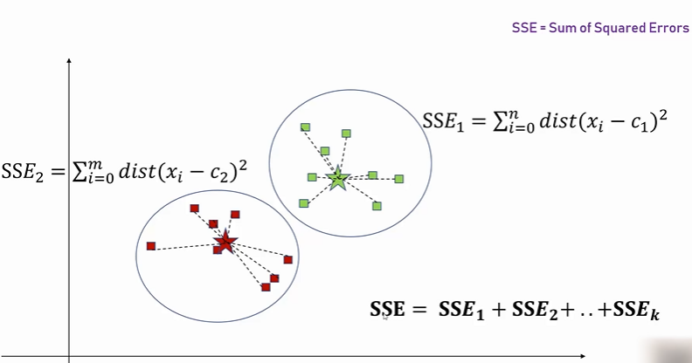
K Means Clustering

Slide 3
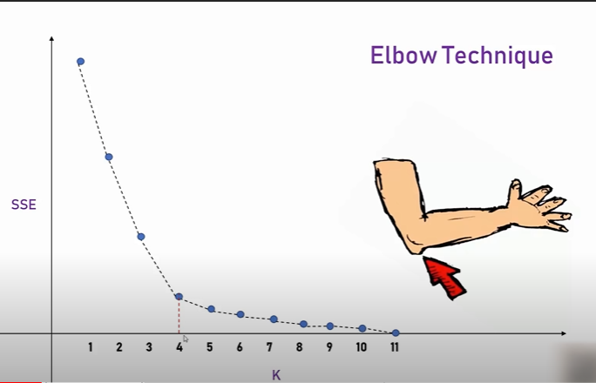
K Means Clustering : Elbow Method

Slide 4
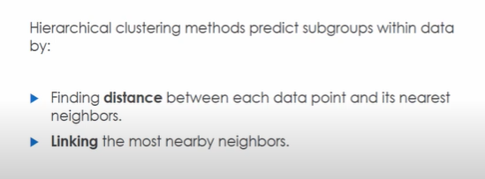
Hierarchical Clustering
Suppose you are a geneticist and you want to differentiate functional groups of genes from many samples. We can do this by seeing expression profile of different genes vs samples.

Slide 5
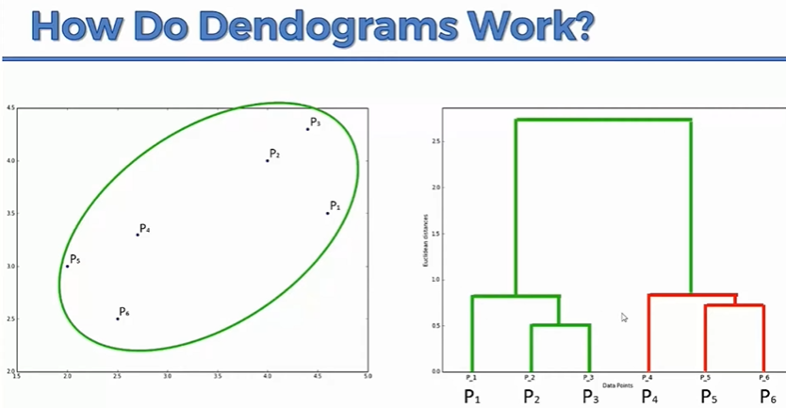

Slide 6
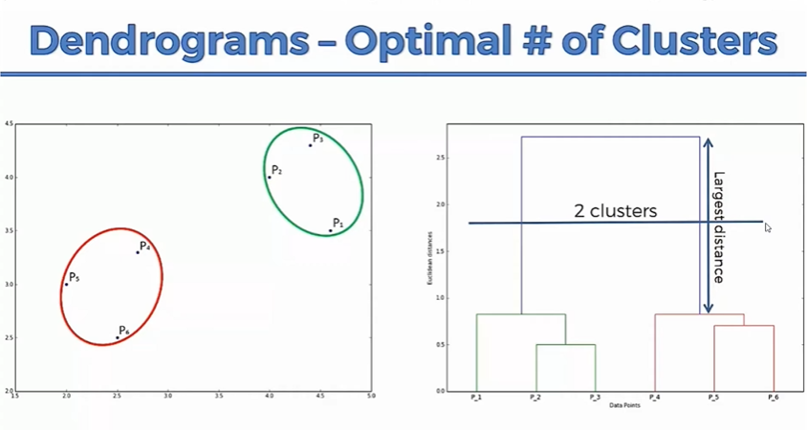

Slide 7
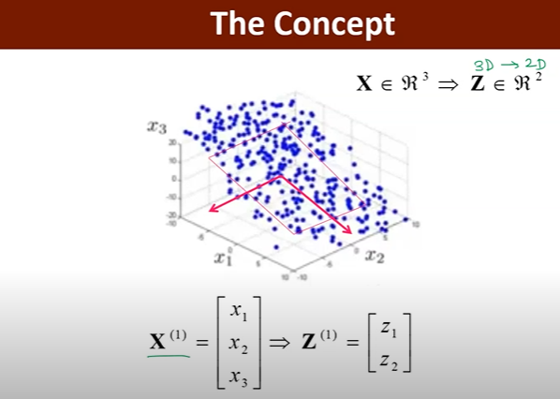
PCA

Slide 8
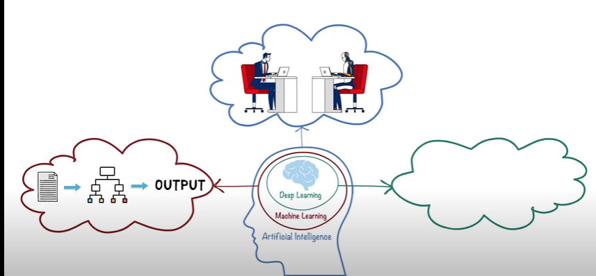
AI, ML and DL
?

Slide 9
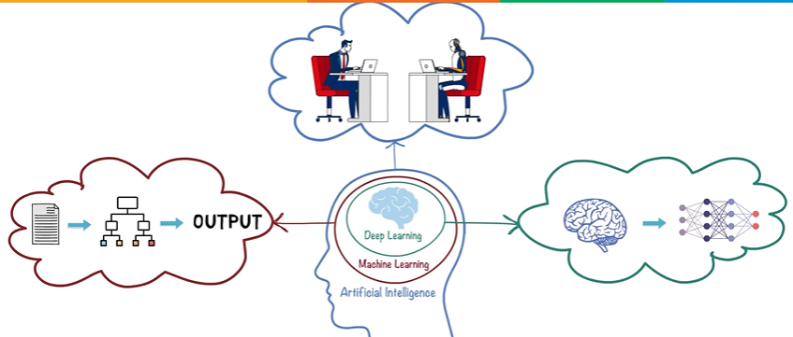
Deep Learning

Slide 10
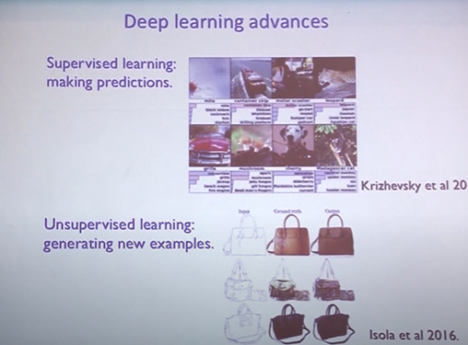

Slide 11
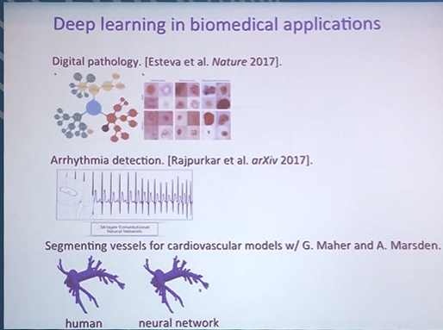

Slide 12
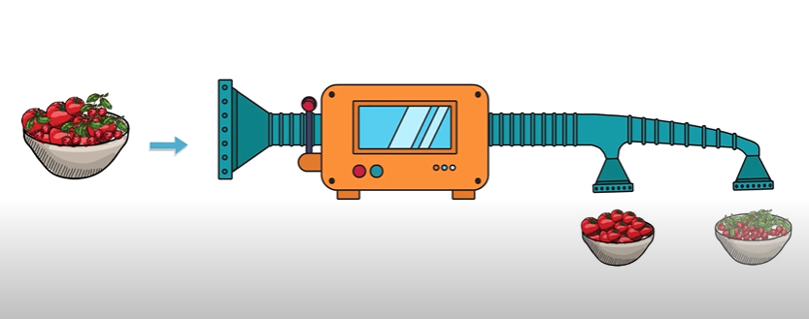
Making an algorithm to differentiate cherries and tomatoes!

Slide 13
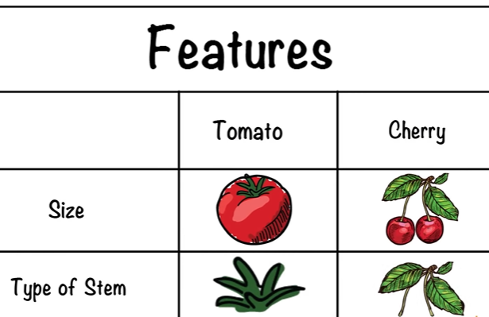

Slide 14
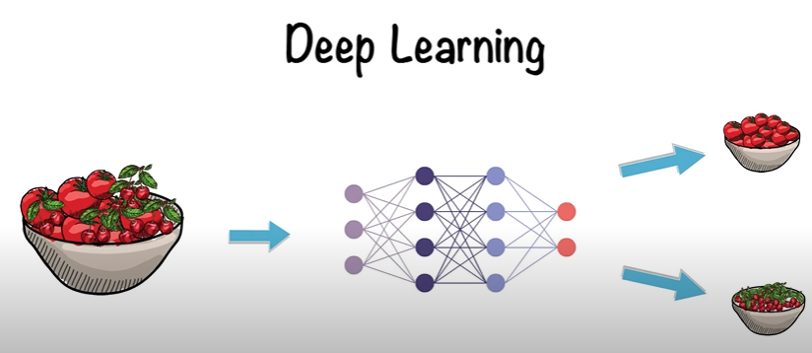

Slide 15
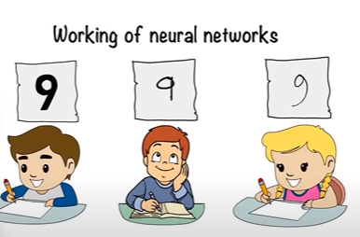
What is an Artificial Neural Network?

Slide 16
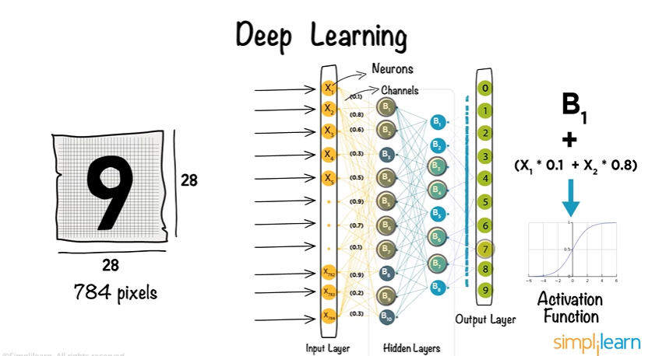

Slide 17
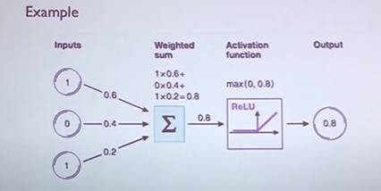

Slide 18
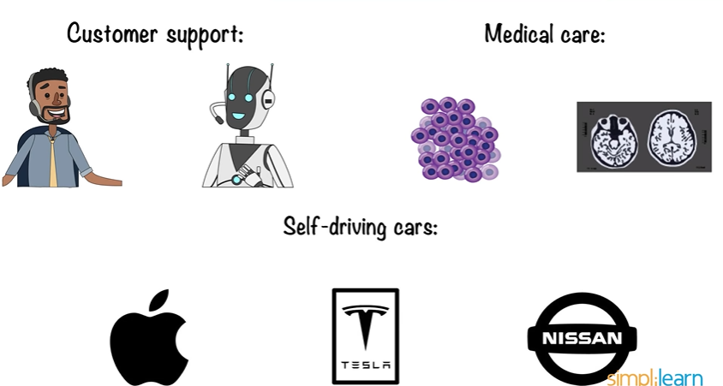
Applications!

Slide 19

Deep learning has a vast scope but has some limitations also!

Slide 20
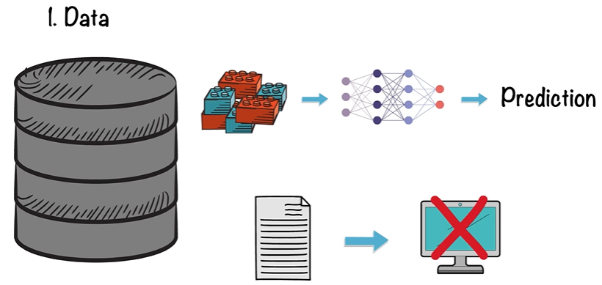

Slide 21
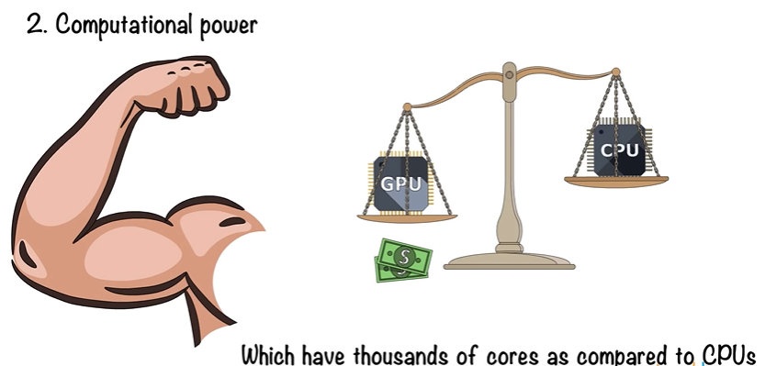

Slide 22
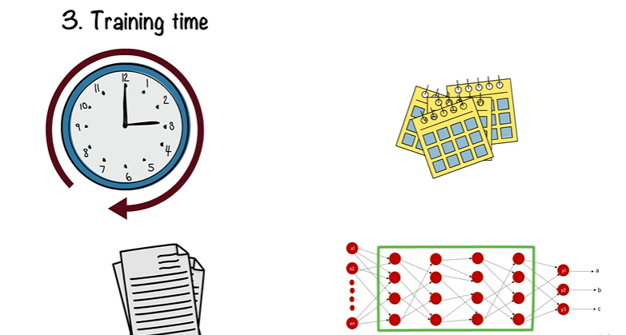

Slide 23
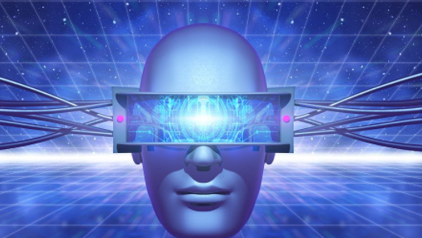
Computer Vision
Computer vision is an interdisciplinary scientific field that deals with how computers can gain high-level understanding from digital images or videos.

Slide 24
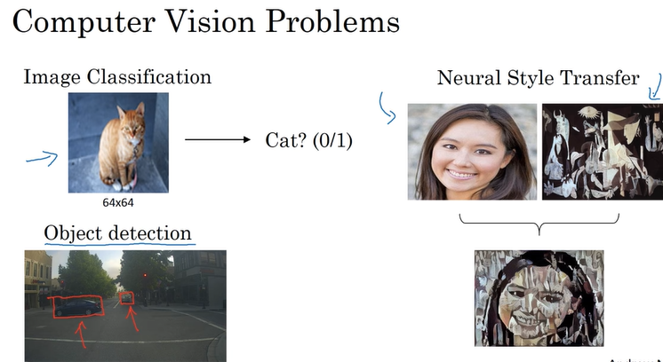

Slide 25
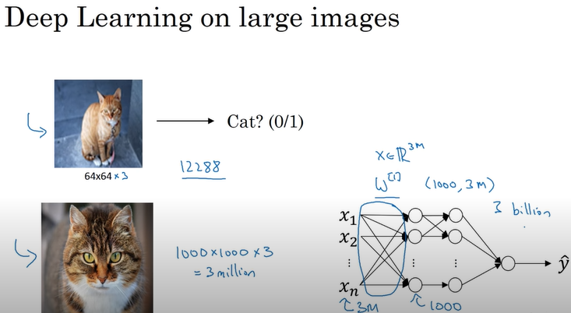

Slide 26
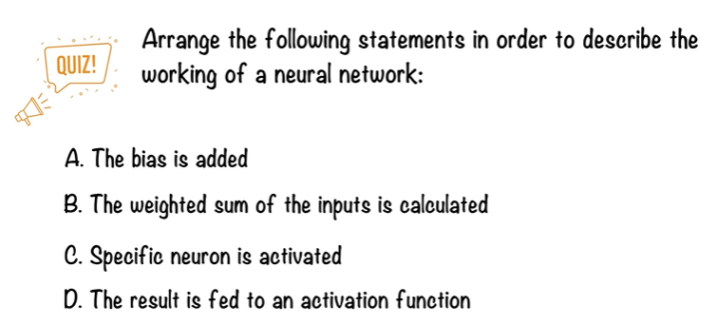

Slide 27
Thankyou ☺

